Slide 1
eltoo Layer 2 Bitcoin Protocol

Slide 2
Agenda
Intro: eltoo paper, Bitcoin protocol requirements
Overview: Definitions and schematic overview
Inner workings: Transaction details
Most important concepts
Concept of state numbering
Signature flag: SIGHASH_ANYPREVOUT
Floating update transactions
Next presentation on eltoo
Other refinements to the protocol, e.g. fee handling, trigger transactions
Comparison to other layer 2 protocols, e.g. Lightning

Slide 3
Intro
History and requirements

Slide 4

Intro: History and requirements
eltoo was proposed as a Bitcoin Layer 2 scaling technique (in 2017?!)
The Bitcoin protocol still lacks functionalities that eltoo requires:
New SIGHASH flags (BIP118)
SIGHASH_NOINPUT (Segwit/Legacy) or
SIGHASH_ANYPREVOUT (Taproot)
Exact difference still unclear to me, only naming?!
Decker et al., “A Simple Layer2 Protocol for Bitcoin”

Slide 5
Overview
Definitions and schematic overview

Slide 6
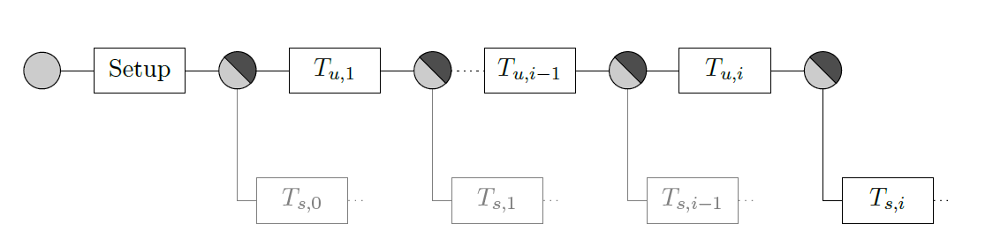

Overview: Definitions, schematics, etc.
eltoo uses separate update and settlement TXs in which the participating parties all hold the same information (information symmetry)
Update transactions $T_{u,i}$ invalidate the older state
Settlement transactions $T_{s,i}$ attach to the respective update TX’s output and hold the current balances
Single party input
Multi party output 0
Multi party output 1
Update TX
Setup / funding TX
(posted on-chain)
Settlement TX 0
Settlement TX 1
Settlement TX
(posted on-chain)
Balance update

Slide 7
Inner workings
Transaction details

Slide 8
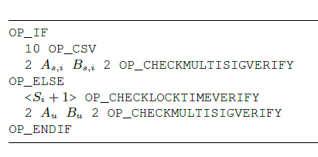
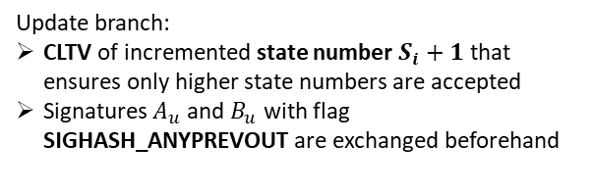
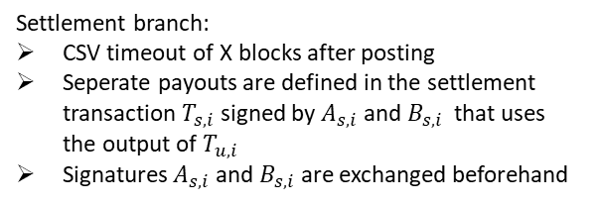
Inner workings: Transaction details
The multisig output scripts of the update TXs (and the setup TX) look as follows:
Setup / update TX output script
Settlement branch:
CSV timeout of X blocks after posting
Seperate payouts are defined in the settlement transaction $T_{s,i}$ signed by $A_{s,i}$ and $B_{s,i}$ that uses the output of $T_{u,i}$
Signatures $A_{s,i}$ and $B_{s,i}$ are exchanged beforehand
Update branch:
CLTV of incremented state number $S_{i}+1$ that ensures only higher state numbers are accepted
Signatures $A_{u}$ and $B_{u}$ with flag SIGHASH_ANYPREVOUT are exchanged beforehand
Two most important concepts in eltoo:
SIGHASH_ANYPREVOUT
State numbering

Slide 9
Inner workings
SIGHASH_ANYPREVOUT

Slide 10
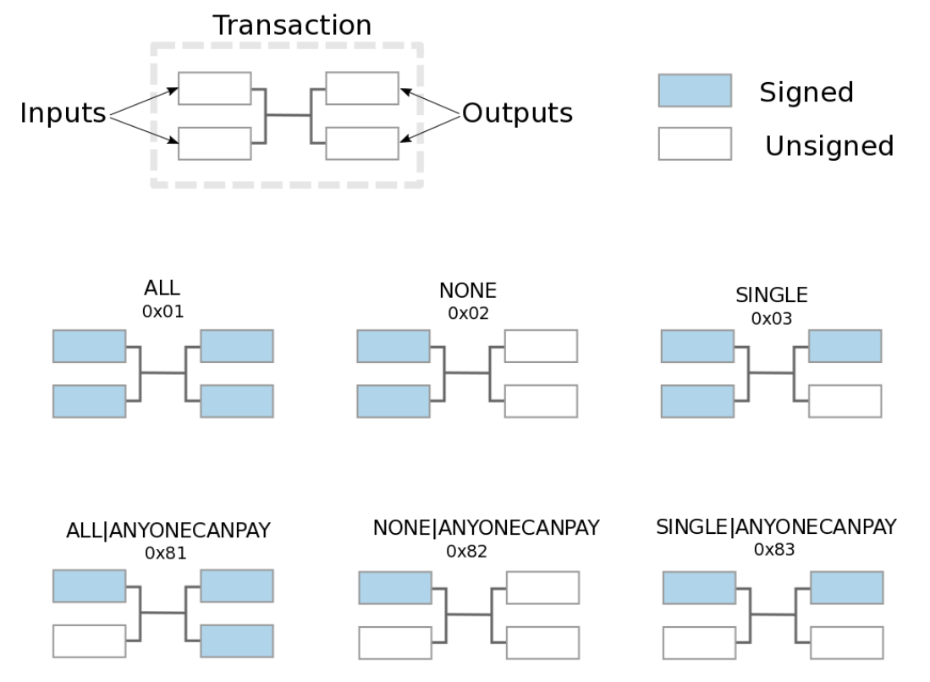
Inner workings: SIGHASH_ANYPREVOUT
Current sighash flags
BIP118
SIGHASH_ANYPREVOUT
previously
SIGHASH_NOINPUT
Not yet part of the Bitcoin protocol!
https://github.com/bitcoinbook/bitcoinbook/blob/develop/ch06.asciidoc

Slide 11
Inner workings
State numbering

Slide 12
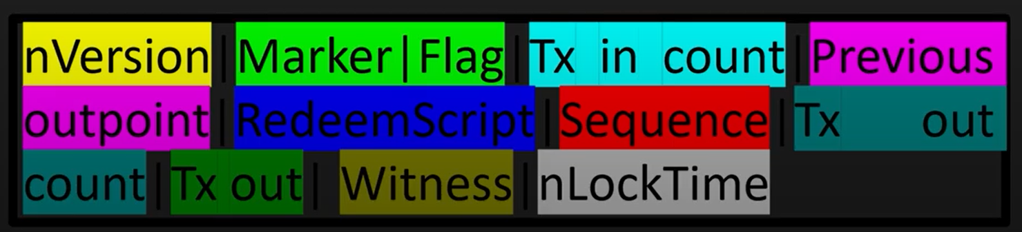

Inner workings: nLockTime & OP_CLTV
nLockTime decides whether a transaction can be mined
needs to be smaller than the current block height / timestamp
Eltoo repurposes nLockTime to
500 000 000 $<$ nLockTime $<$ current UNIX timestamp
Can always be mined
NLockTime represents state number instead
Allows the usage of OP_CLTV in output scripts to check whether:
state number of new update TX is higher than previous one
Bitcoin TX fields
Two cases:
nLockTime > 500 000 000
Specifies a UNIX timestamp (current UNIX timestamp ~1 600 000 000)
nLockTime < 500 000 000
Specifies a block height

Slide 13

Inner workings: State numbering
State numbers $S_{i}$ in eltoo are put into
The output script with an increment of 1: $S_{i}+1$
The nLocktime field of the respective update transaction: nLockTime $=S_{j}$
In case of an on-chain posting, OP_CLTV checks whether: $S_{j}=$ nLockTime $≥S_{i}+1$
Setup / update TX output script
Bitcoin TX fields
https://www.youtube.com/watch?v=E8NXlI9wi84

Slide 14
Inner workings
Floating update TXs (putting it all together)

Slide 15
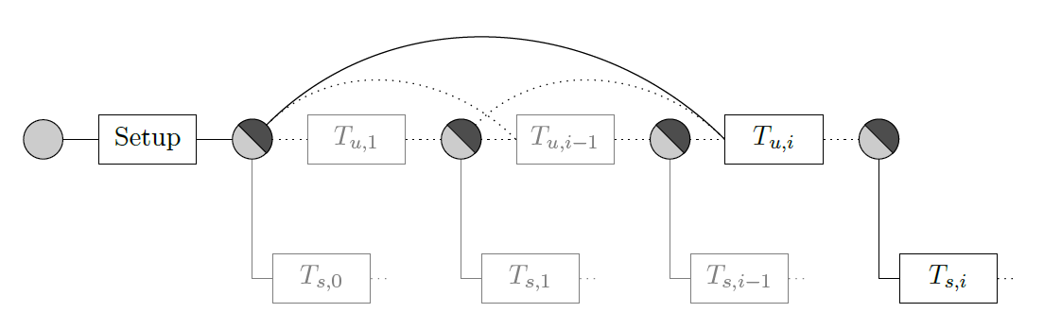
Inner workings: Floating update TXs
With the introduction of state numbering and the usage of SIGHASH_ANYPREVOUT, floating update TXs can be realized
SIGHASH_ANYPREVOUT:
Update TXs can bind to the previous multisig outputs of any previous update TX (or the setup TX)
State numbering:
If old (actually invalidated) update TX is posted on-chain, newer update TX can just spend it

Slide 16
Next presentation(s) on eltoo
Refinements / extensions of the eltoo protocol
Fee handling
Trigger TXs (making timeouts more flexible)
Extending to more than two parties (Symmetric information, Taproot)
Comparison to other layer 2 protocols
Lightning, Duplex channels, etc.
More “exotic” approaches, e.g. Covenants (https://anyprevout.xyz/)

Slide 18
Layer 2 Bitcoin Protocols
Layer 2 Bitcoin protocols are based on exchanging (partly) signed Bitcoin transactions and holding them off-chain until an on-chain settlement
Update
Update
Update
Off-chain
On-chain
Funding
Settlement

